Slide 1
Modular walk in cold and freezer rooms
From Lowe

Slide 2
Why Coldroom storage?
At capacity and need additional storage for frozen or fresh produce?
Undergoing refurbishment and need temporary frozen storage?
With over 40 years experience and knowhow, Lowe Rental are worldwide specialists in refrigeration and coldroom rental offering the perfect solution for your fresh and frozen modular storage.
Expecting a busy season and want to maximise sales with higher stock volumes?
Exhibiting and want to ensure your products are fresh to stand?

Slide 3
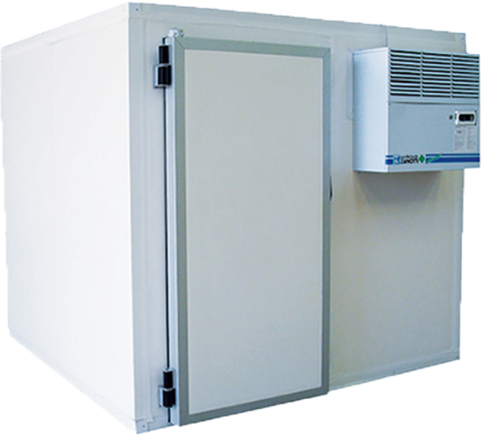
Overview
Lowe Rental have the largest fleet of temporary walk-in coldrooms in the world.
Our coldrooms are unique, versatile and engineered for efficiency.
They can be quickly built on-site, indoors or outdoors and designed to any size requirement or configuration.
Perfect for:
  Retail environments
  Restaurant kitchens of any size
  Corporate catering at events
  Exhibition Storage

Slide 4
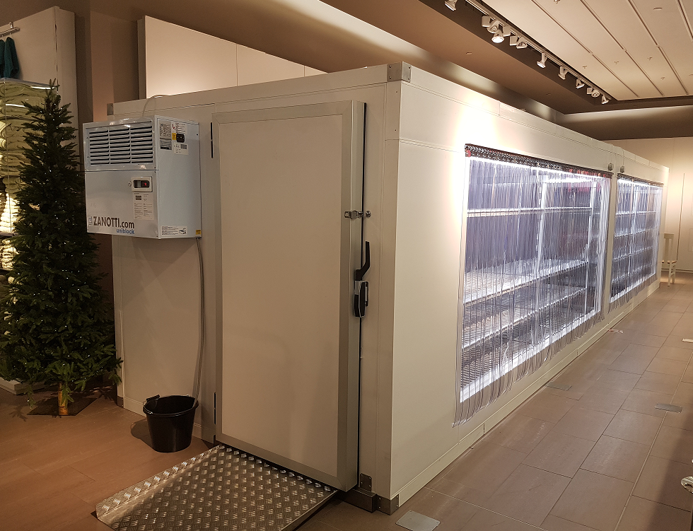


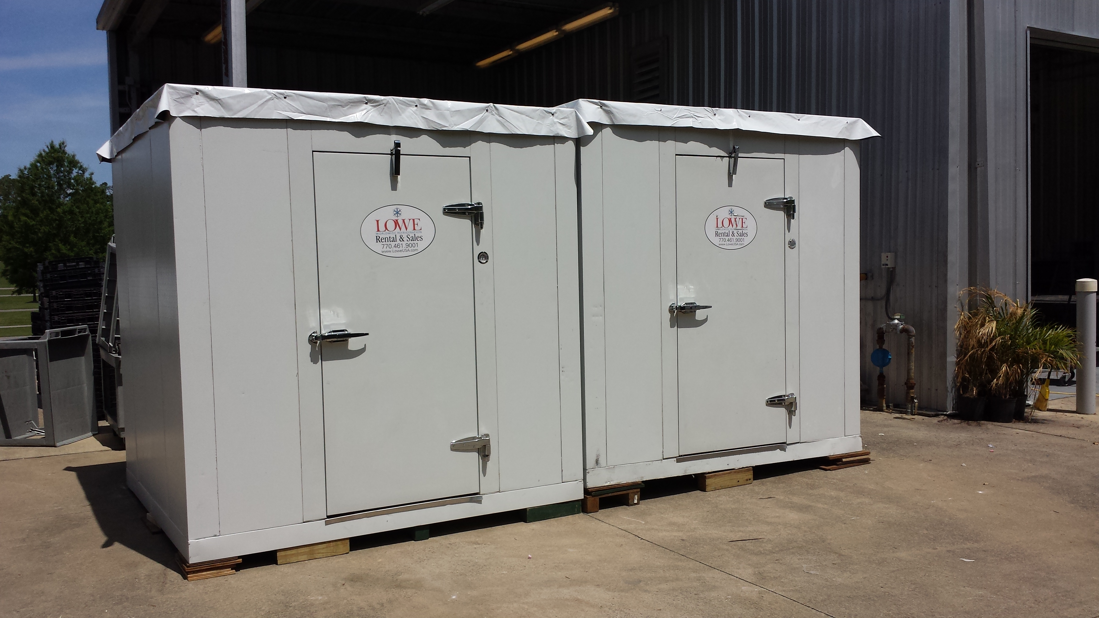
Retail – remodels and seasonal trading
With a range of sizes Lowe coldrooms have the ability to accommodate any store layout.
They can be quickly built on site, indoor or outdoor, and designed to any size requirement up to 40ft.
Perfect for storing dot com orders for online trading or for stores with access restrictions and limited space.
They limit the exposure to loss of stock and are perfect for bulk storing refrigerated and frozen goods.

Slide 5
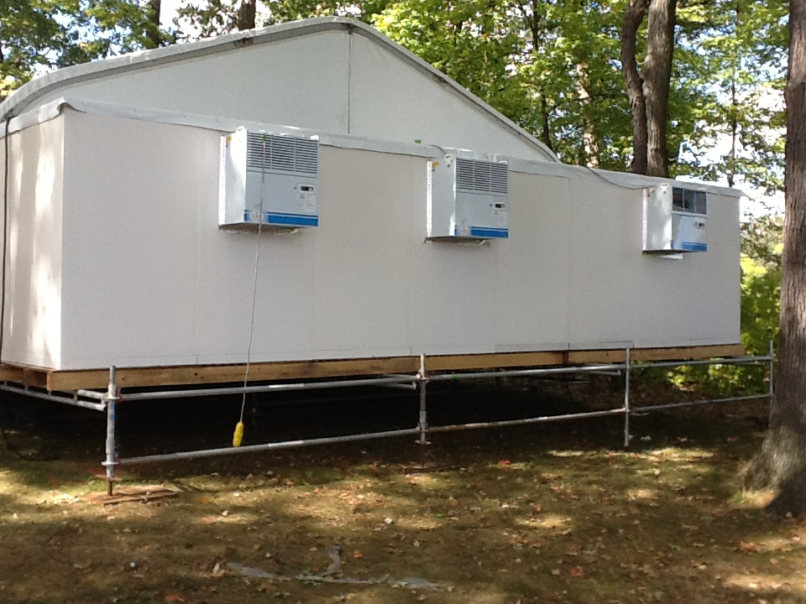

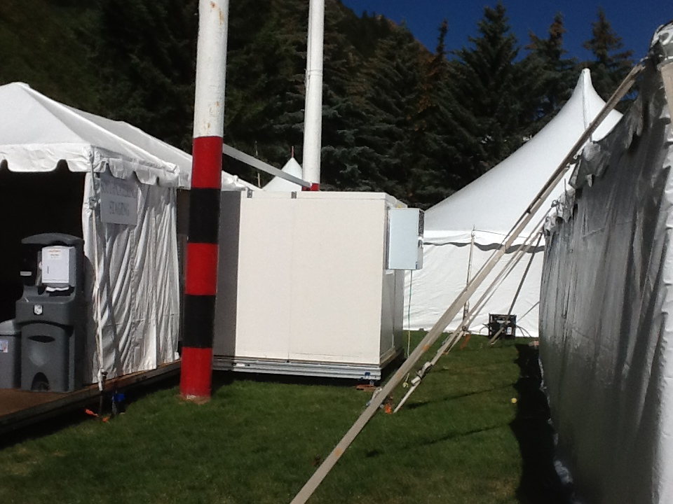
Kitchens, corporate catering and events
Chefs can have additional refrigerated storage for access to their produce – right next to them.
With location flexibility, Lowe coldrooms are the perfect solution for corporate catering at any event.
Lowe coldrooms can be built in or attached to any structure without being intrusive.
The Lowe coldrooms are quick and efficient to assemble for use in kitchen refurbishment or emergency break down.
Modular functionality gives capability of using multiple doors, ideal for use in high volume production kitchens.

Slide 6
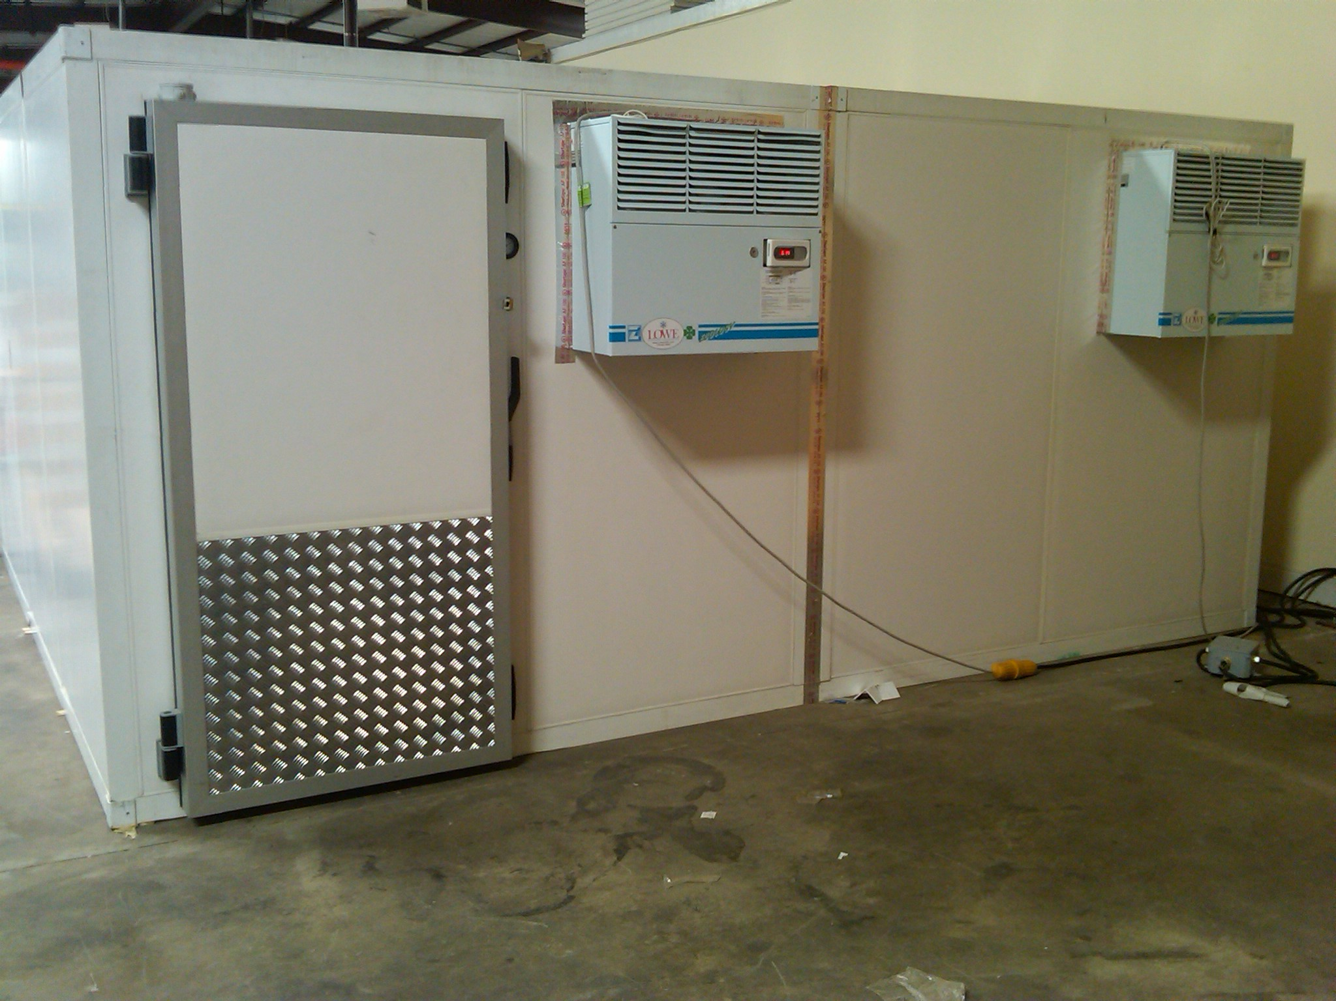
Exhibitions
Provides off stand additional refrigerated and frozen storage.
Ensures your produce is fresh, from delivery through to displaying and sampling at your stand.
Offers an alternative storage solution while your stand is being built – for full peace of mind.
Can be conveniently built and situated within the exhibition centre for delivery convenience.

Slide 7



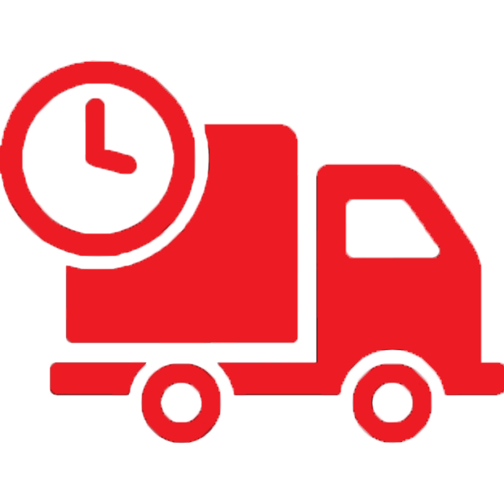
Benefits
Flexible
Sales
Choose from our varied sizes as well as our versatile walk-in coldrooms which can be built in most locations with dual temperature functionality.
Lowe Rental can help your business promote and sell more products, increasing sales and maximising profit.
Service
Delivery
Full 24/7 technical backup is provided with each rental and each cold room is supplied with additional accessories such as a ramp and internal racking, if required.
Our coldrooms are delivered flat packed meaning vehicular access isn’t needed and our quick and efficient on-site build process saves you time and money.

Slide 8
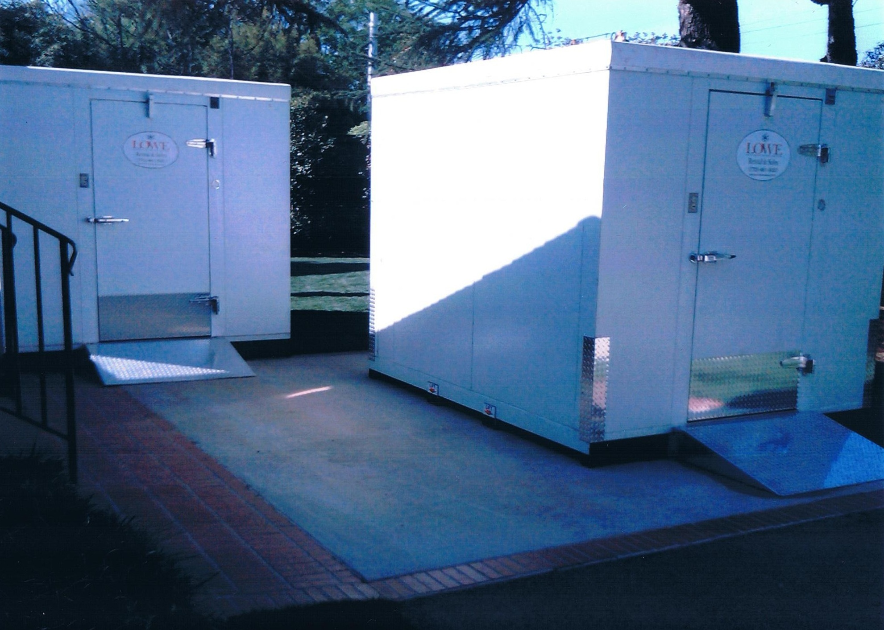
Features
30amp single phases power requirement
Fan assisted cooling
Automatic defrost
Digital temperature display
Dual temperature function between –13…+50 °F
4 inch thick polyurethane insulation
Self extinguishing panels in the event of fire on some models
Easy clean plastic with Food Safe interior on some models
Lockable door & internal emergency door release feature

Slide 9
Racking
Ideal for a range of storage solutions
Accessories available
Chill strips – Included!
Chill strips prevent draughts & assist temperature control during loading/unloading your coldroom
Pallet doors
Pallet size doors are also available for access to your coldroom
Ramps
Ramps ideal for roll cage & jackstack operations for easy loading/unloading from your coldroom
Additional Motors
Increase your temperature control with an additional motor
Extension Lead
Our coldrooms come with Commando plugs and a 1.5-2m lead. Extension leads are available if your coldroom is positioned away from your power source
Python Holes
Python cut coldroom panels suitable for beer keg piping

Slide 10
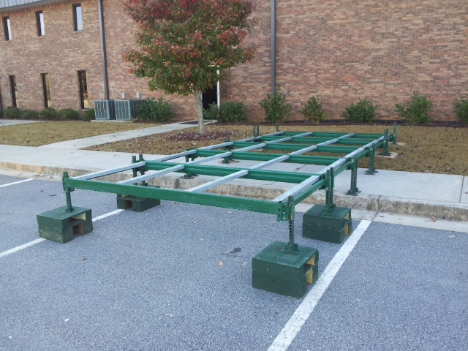
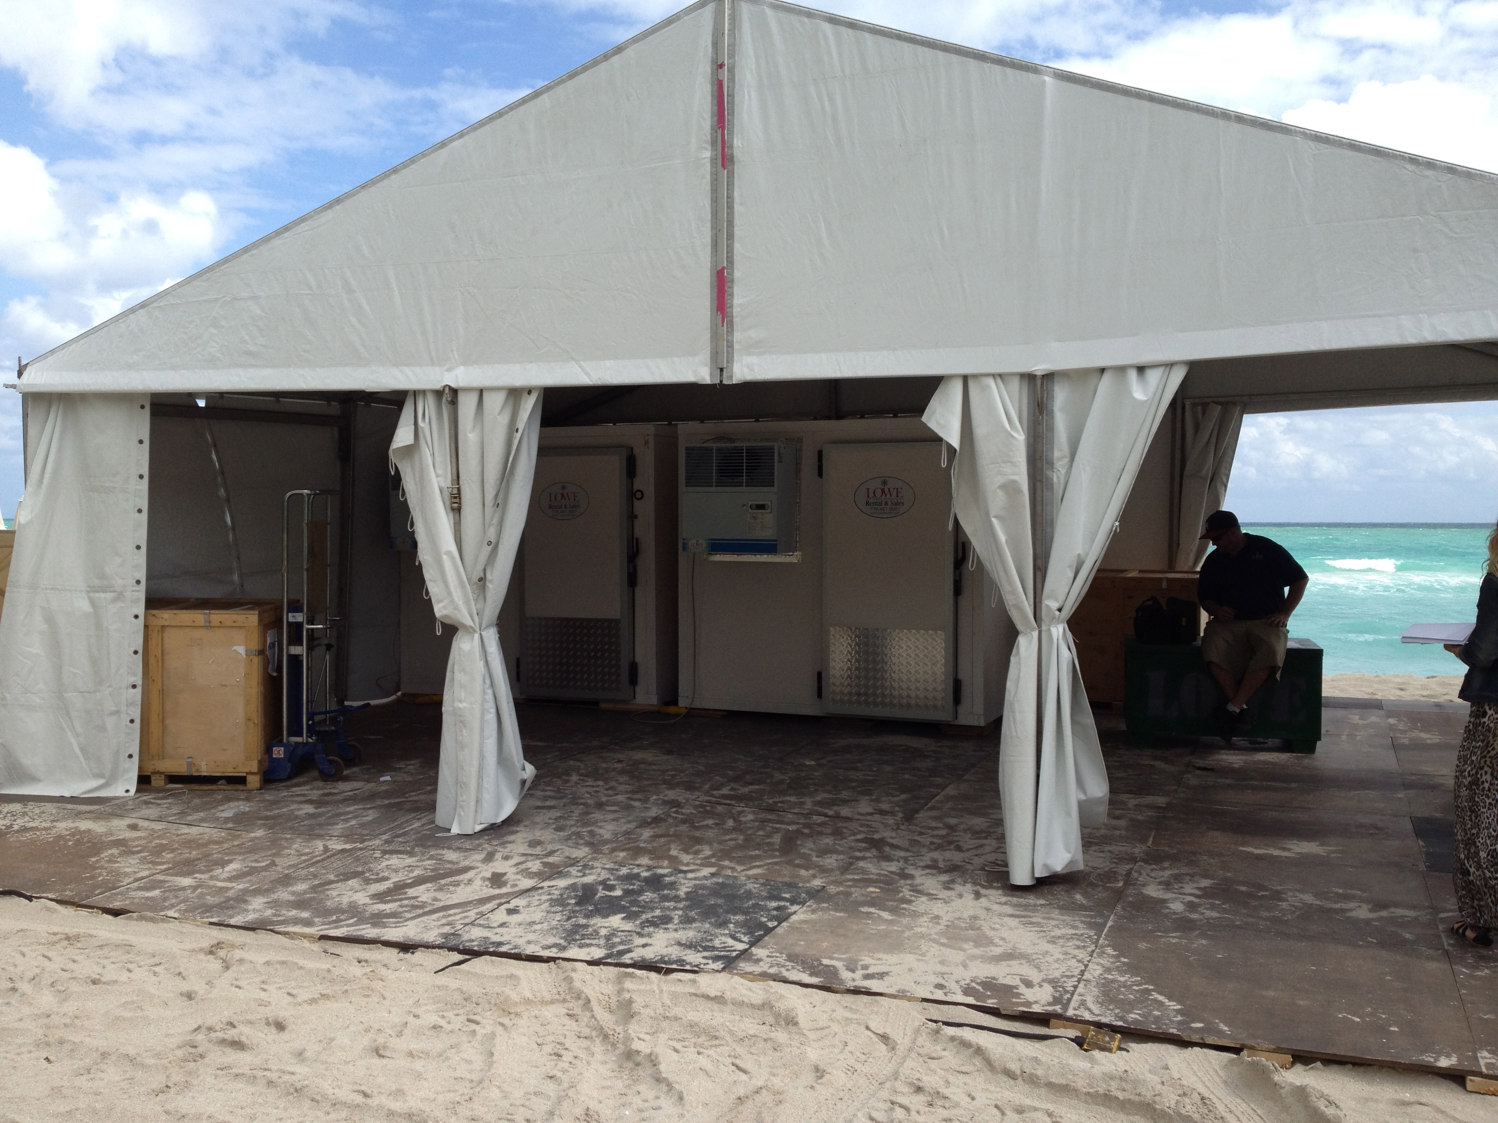
Cold storage – Where you need it. When you need it.
Lowe Rental can support your company anywhere with modular coldrooms.
Our coldrooms offer a clean, safe and quiet refrigeration and frozen storage option in almost any environment.
If required, our steel frame levelling system allows us to place coldrooms almost anywhere.
Uneven or sloping ground
On the beach
On dirt, gravel or asphalt
On a platform
Under a bridge
Inside a building
Inside a room
On a rooftop
At limited access or remote locations

Slide 11
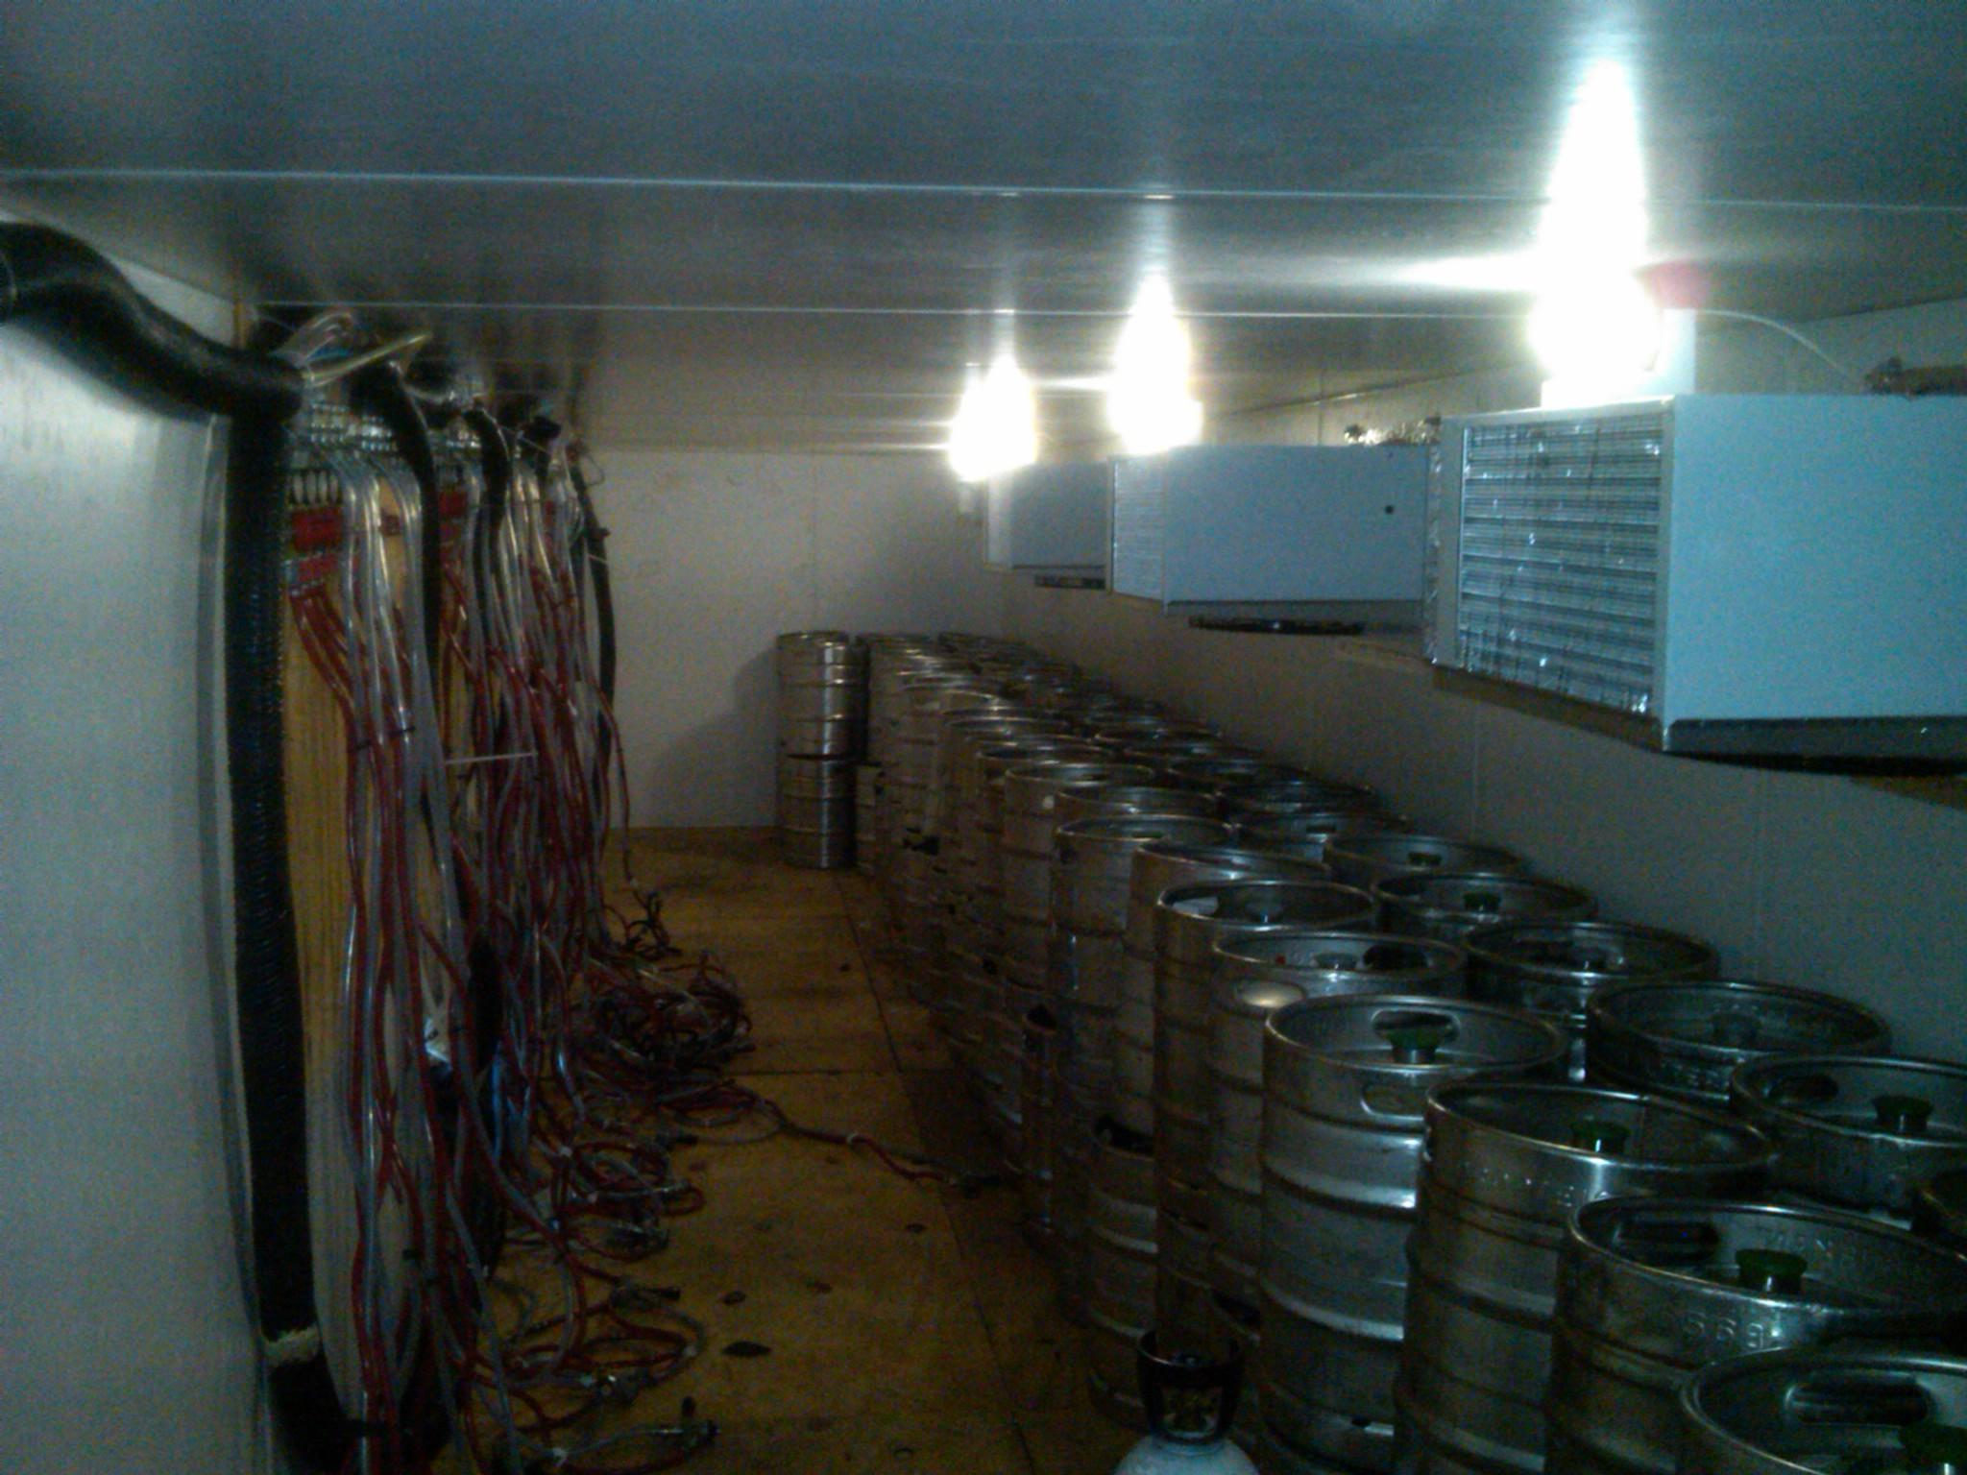
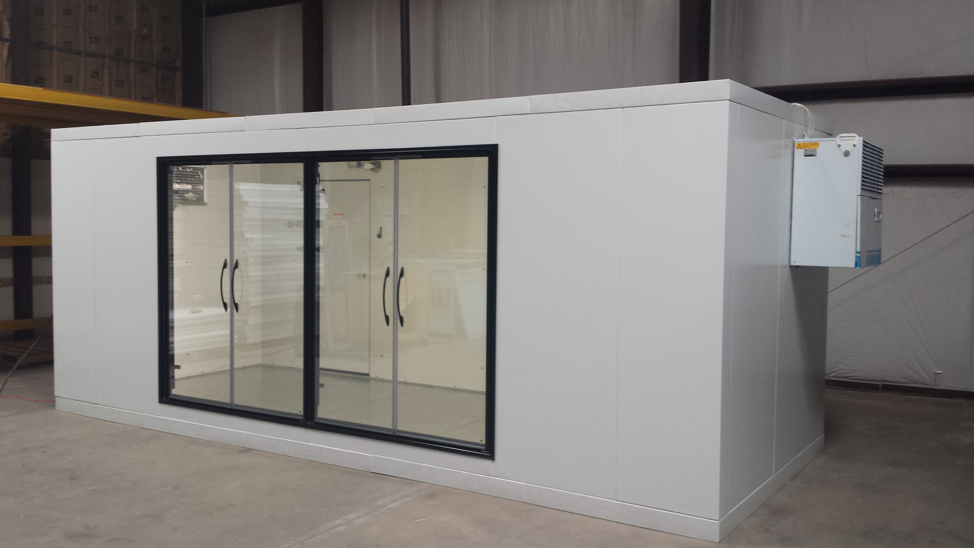
The opportunities are endless
In addition to being able to provide these to remote locations, indoor and outdoor and to any size requirement, these versatile rooms can also provide:
Temperature control preparation room
Glass door entry

Slide 12
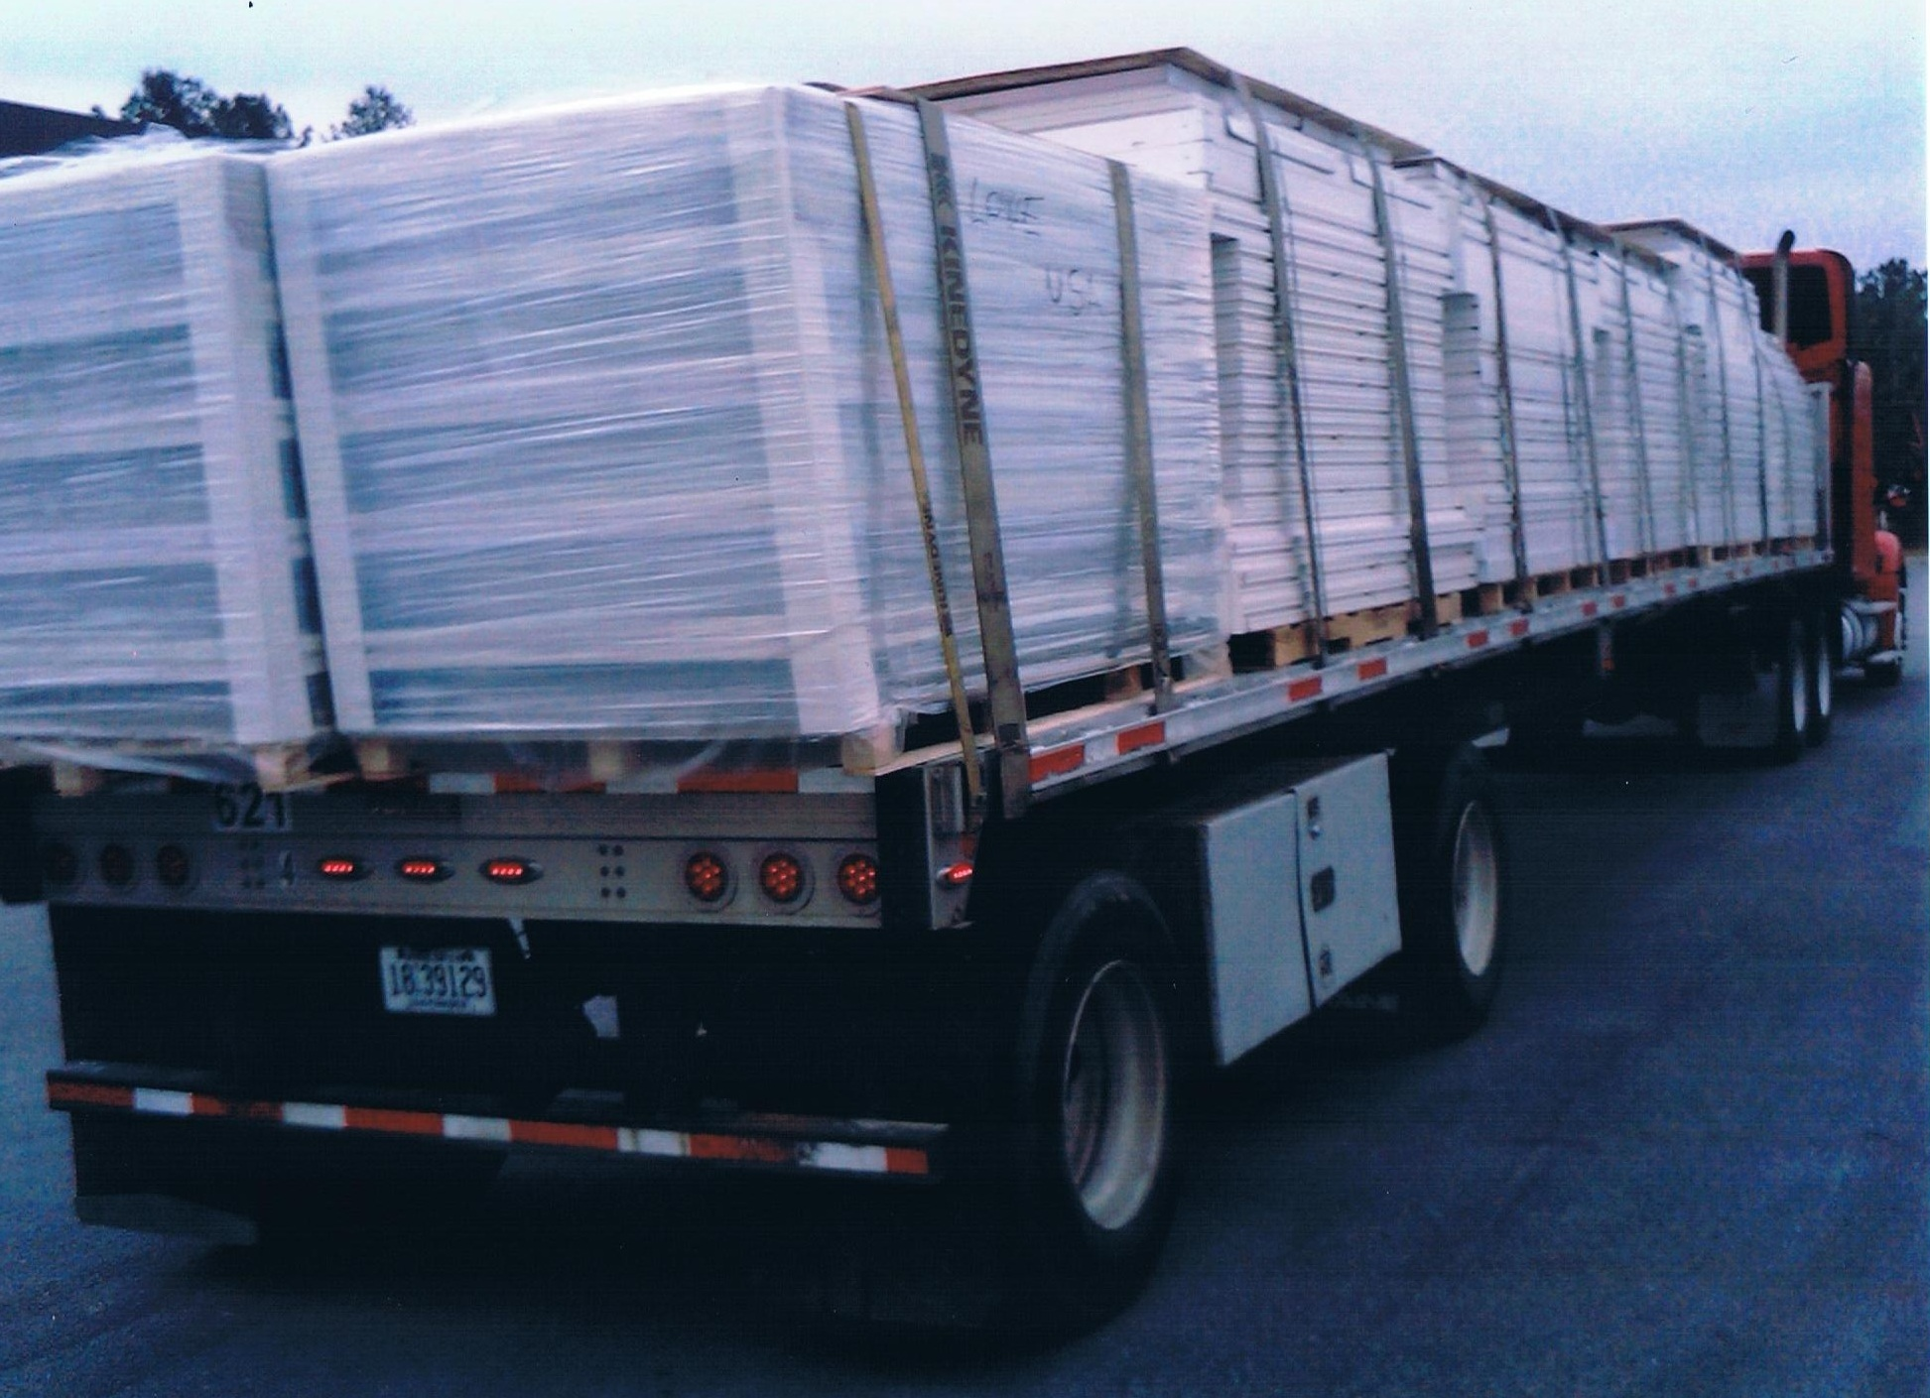
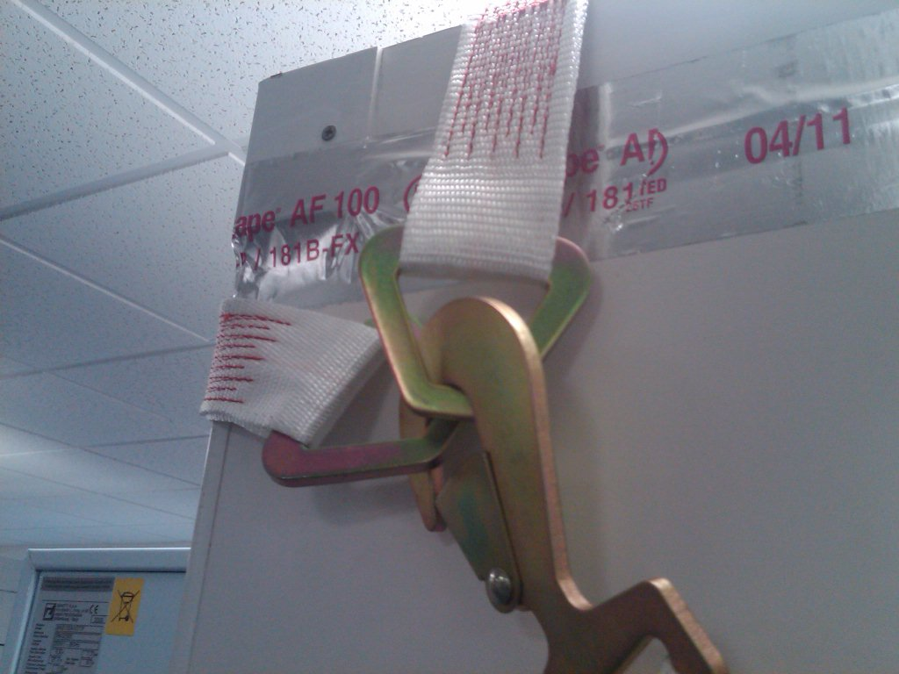
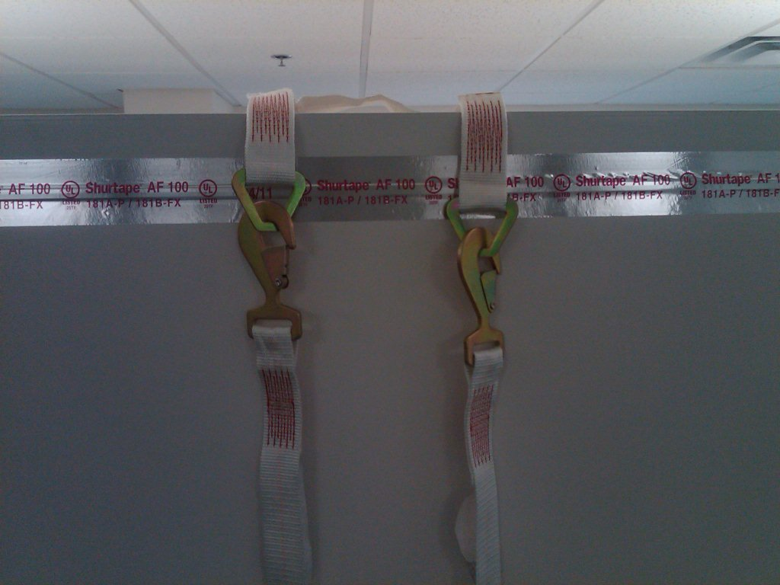
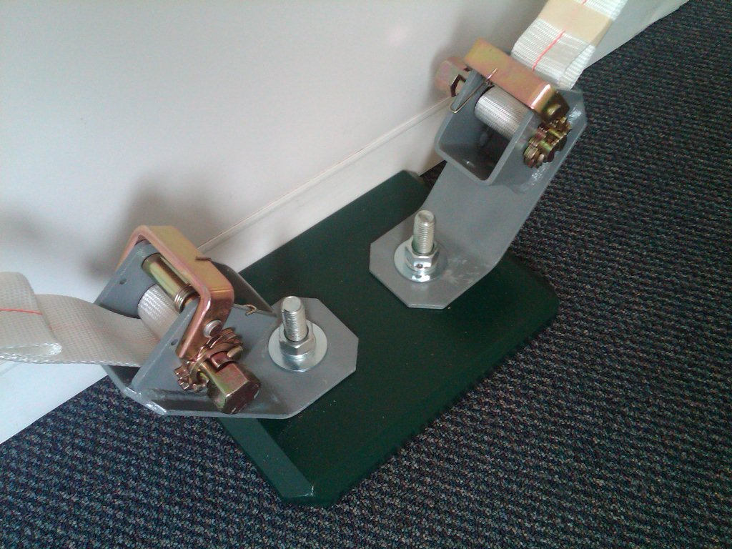
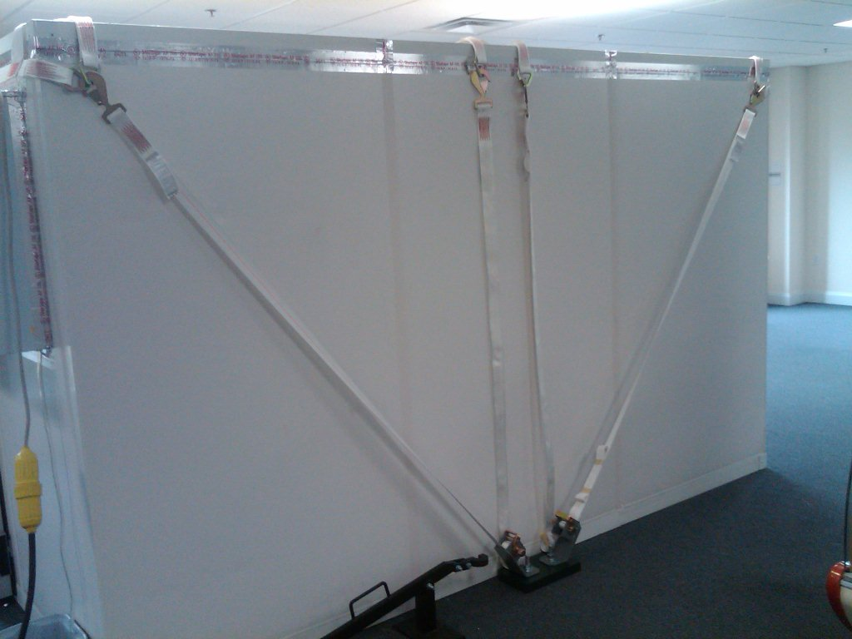
Freight and Shipping
Lowe Rental’s extensive logistical program enables us to meet your unique requirements and ensure on time delivery to your location.
A large number of coldrooms can be loaded onto a single trailer making deliveries more efficient and cost effective
Tie down straps can be placed over modular cold tooms to provide extra security in high wind environments. Strapping uses a ratchet and stake system that allows each unit to be pinned in place.

